Slide 1
BTP Presentation
Pavan Kalyan(2019102039)
Vinay Kumar(2019102045)
Sai Saharsh(2019102012)

Slide 2
Studied the files which contains the readings of accelerometer
Converted the given files to .csv files using C++ which converts every file in a folder at a time.
PLOTTING
Uploaded the csv files to MATLAB and plotted the signals for each file in a folder at a time.

Slide 3
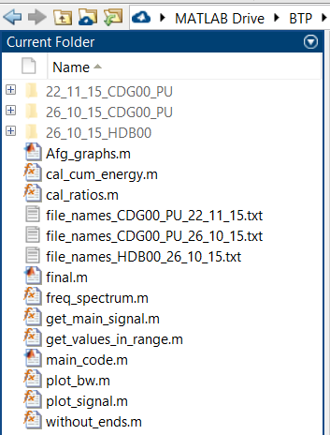
These are the data folders and code files in matlab
Run main_code.m for all the results
Remaining files and functions are internally required files/functions for main_code.m
The visible three text files contains the names of the .csv files in the respective(according to their name) data folder.

Slide 4

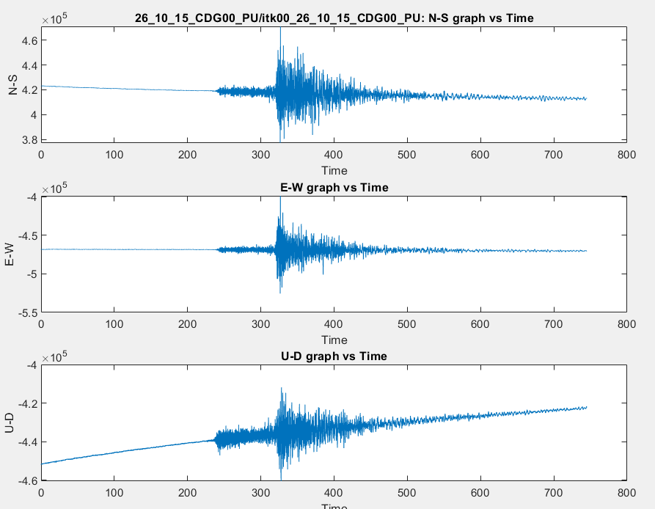
Plotted the three signals(north-south, east-west, up-down) of a sensor

Slide 5
The signal contained noise which was due to some external disturbances.
We applied a band pass filter that removes the noise in each signal and plotted the resultant signal.
Frequency range of band pass filter is 5Hz to 49Hz.
Then, we plotted the Fourier transform to the signal.
Calculated ratios of frequency spectrums of respective sensors.

Slide 6
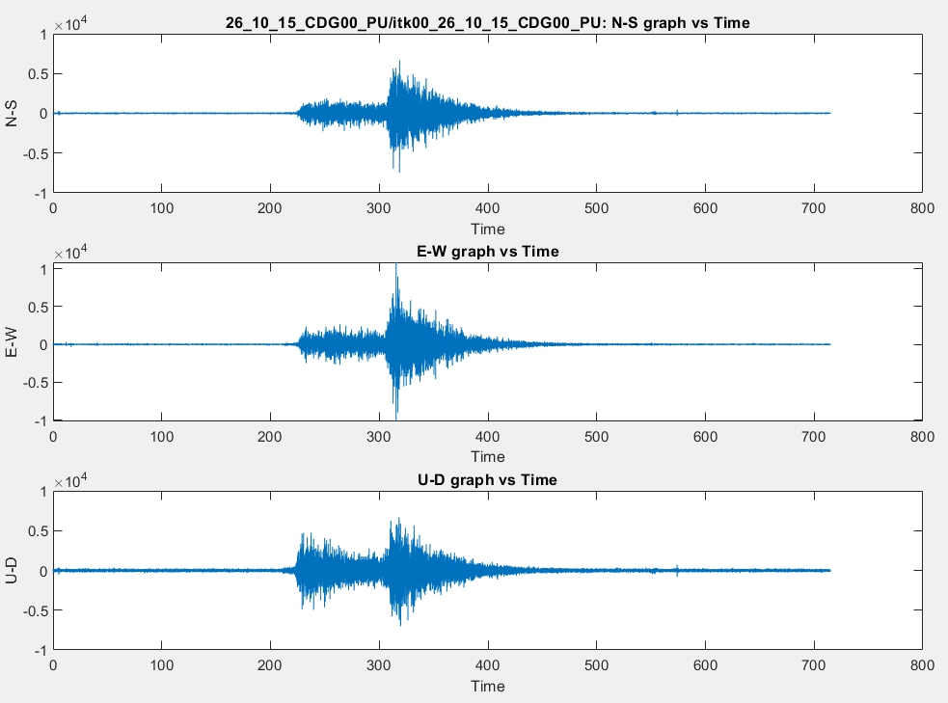
Denoising of a signal
plot_bw.m plots the denoised signal. It passes the signal through a bandpass filter(5Hz – 49Hz)
Unwanted side signal has been cut

Slide 7
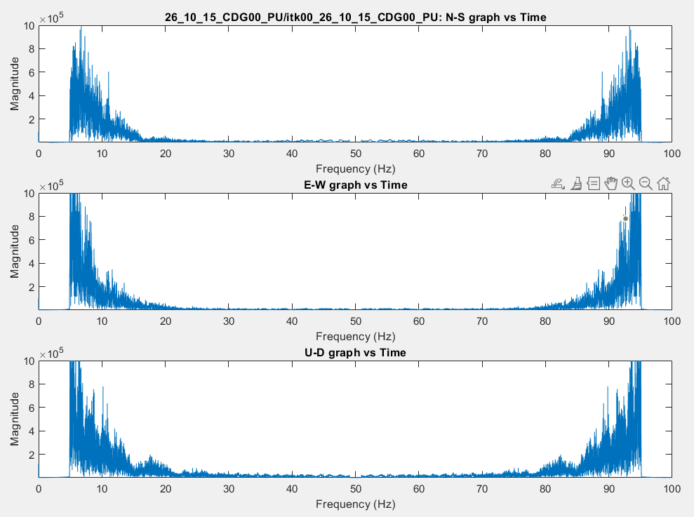
Frequency spectrum
freq_spectrum.m plots the frequency spectrum of the signal

Slide 8
Calculating ratios for different floors
Plotted the ratios of different floors (itk003/itk000,itk006/itk003) which tells us the motion of different floors with respect to each other
itk009
itk006
itk007
itk008
itk003
itk004
itk005
itk000
itk001
itk002

Slide 9
Extracting the signal which contributes the most to the total signal
Calculated the cumulative energy across the signal and divided each energy value to the total energy.
Then, we cut the signal from 0.05-0.95 and plotted it(This part contributes most to the signal).
Things we are stuck with:
Wavelet transform

Slide 10
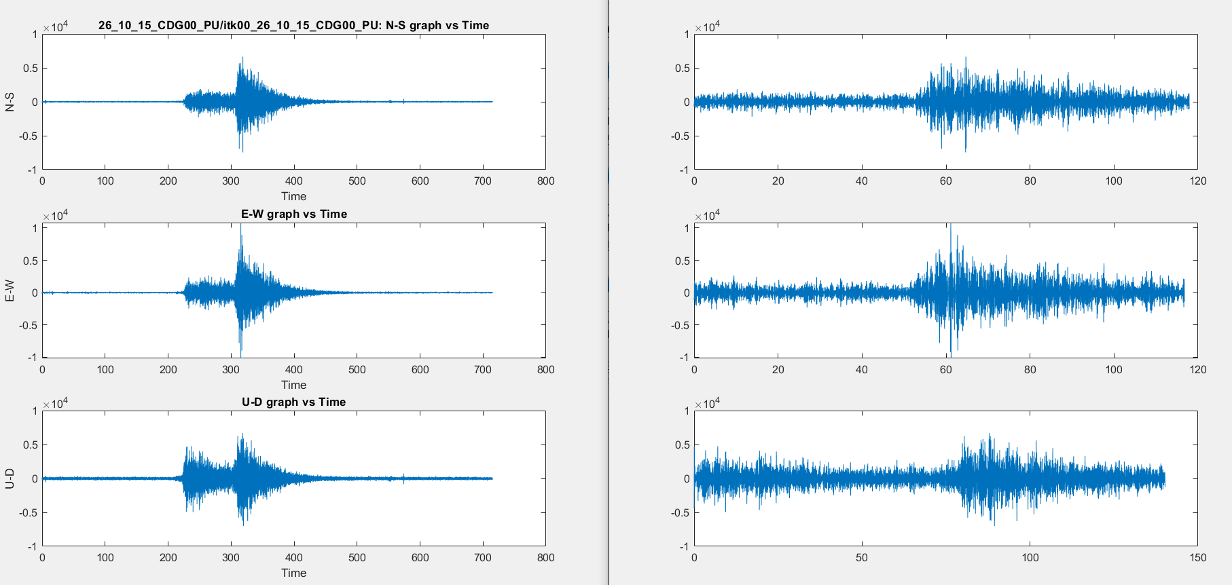
Extracted important portion of the signal

Slide 11
Cut the frequency spectrum
Found Amax
Found duration of each signal

Slide 12
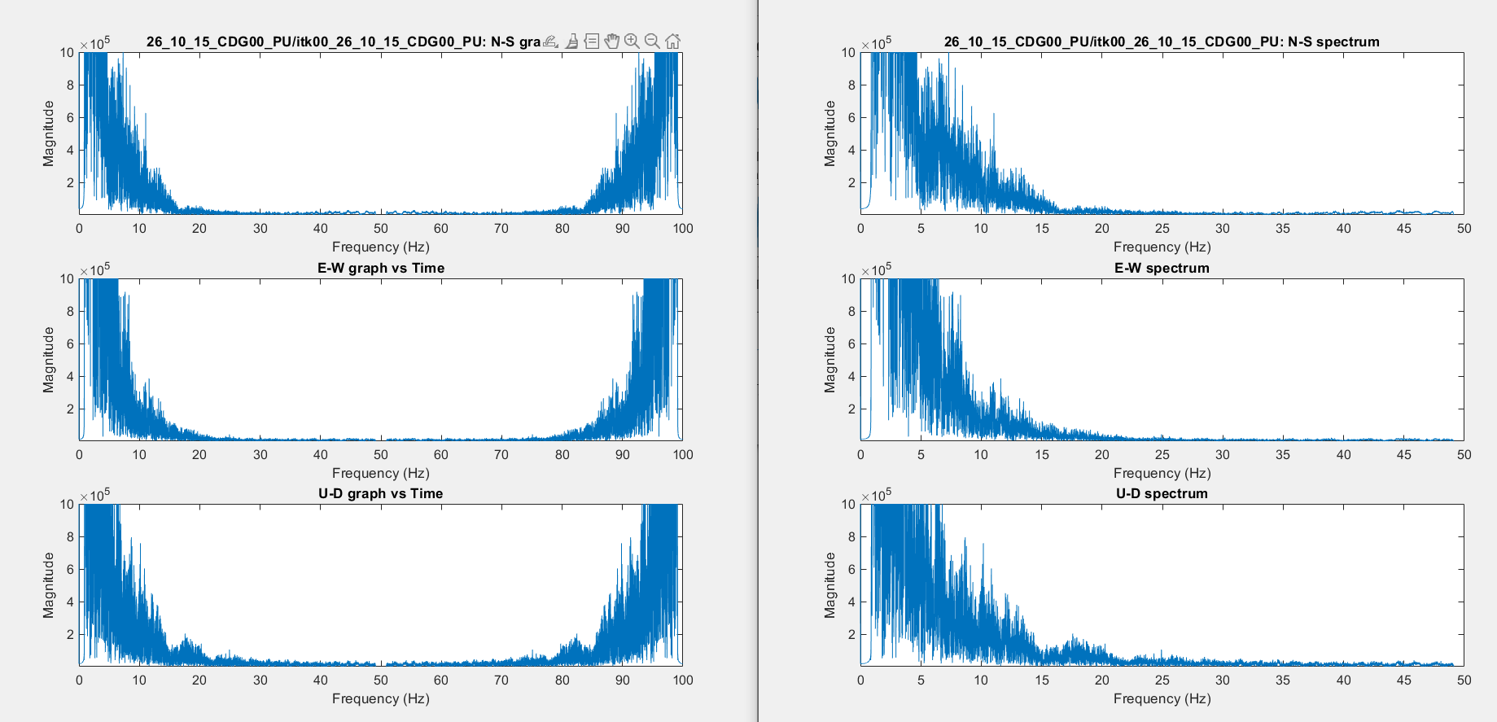
Frequency spectrum

Slide 13
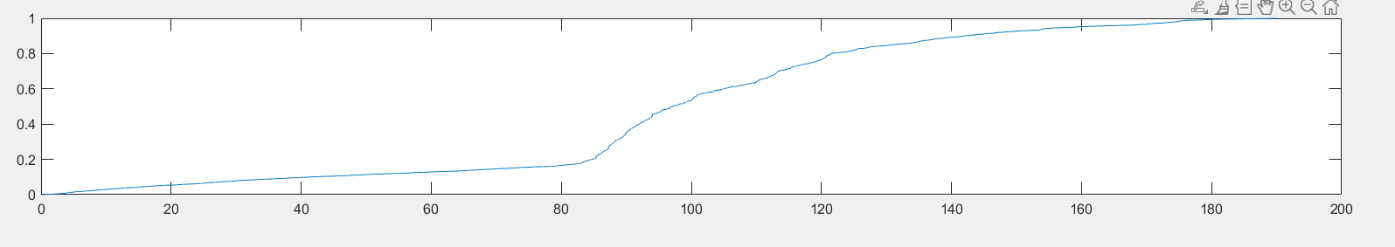
Energy signal

Slide 14
CDG00_PU_26_10_15
itk00 | Amax(x10^4) | T(duration)
N-S | 3.63 | 75.3
E-W | 5.90 | 74.5
U-D | 1.94 | 144.5
itk01
N-S | 4.96 | 75.4
E-W | 7.95 | 68.1
U-D | 2.14 | 140.6
itk00
N-S | 7.97 | 74
E-W | 10.78 | 66
U-D | 1.88 | 141.2

Slide 15
CDG00_PU_22_11_15
itk00 | Amax(x10^3) | T(duration)
N-S | 4.86 | 82.09
E-W | 5.35 | 71.13
U-D | 3.27 | 120.82
itk01
N-S | 6.13 | 69.05
E-W | 7.46 | 67.21
U-D | 3.81 | 118.80
itk00
N-S | 11.65 | 68.94
E-W | 11.43 | 65.14
U-D | 3.83 | 119.60

Slide 16
HDB00_26_10_15
itk00 | Amax(x10^2) | T(duration)
N-S | 14.57 | 159
E-W | 7.07 | 173
U-D | 28.07 | 173
itk01
N-S | 6.02 | 172
E-W | 6.65 | 169
U-D | 14.24 | 168
itk00
N-S | 8.19 | 173
E-W | 9.38 | 168
U-D | 9.21 | 172

Slide 17
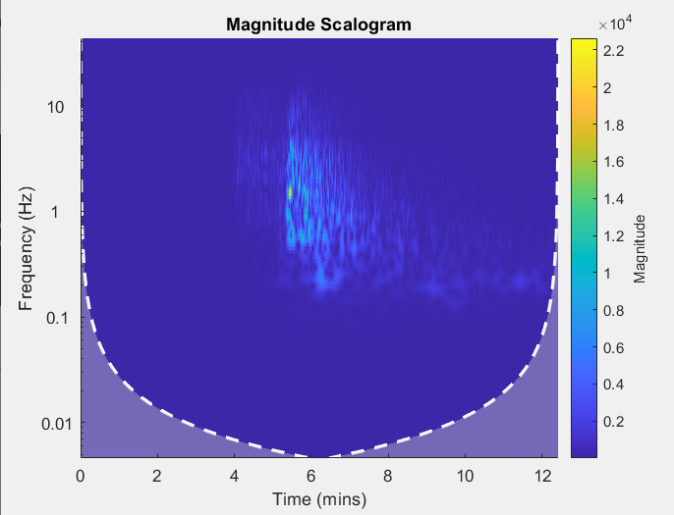
Wavelet transform of given data(2D)

Slide 18
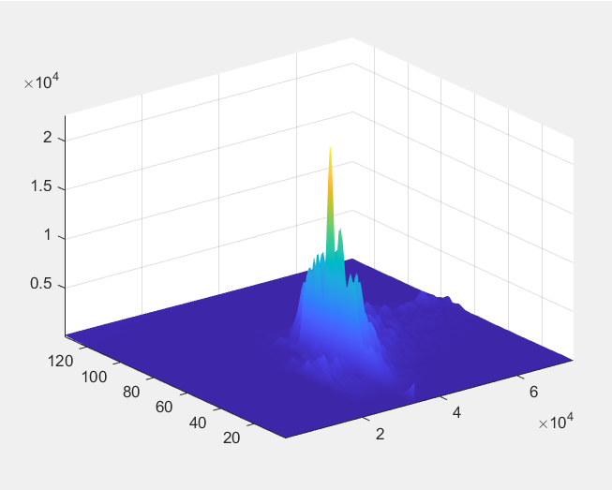
Wavelet transform of given data(3D)

Slide 19

THANK YOU

